Slide 1

pythia
- Richard scott

Slide 2

The social covid tracking app
Uses a social media-like interface to engage users
Easy – to – use custom interface designed for 21-60 demo
Minimal data collection to aid in user trust

Slide 3
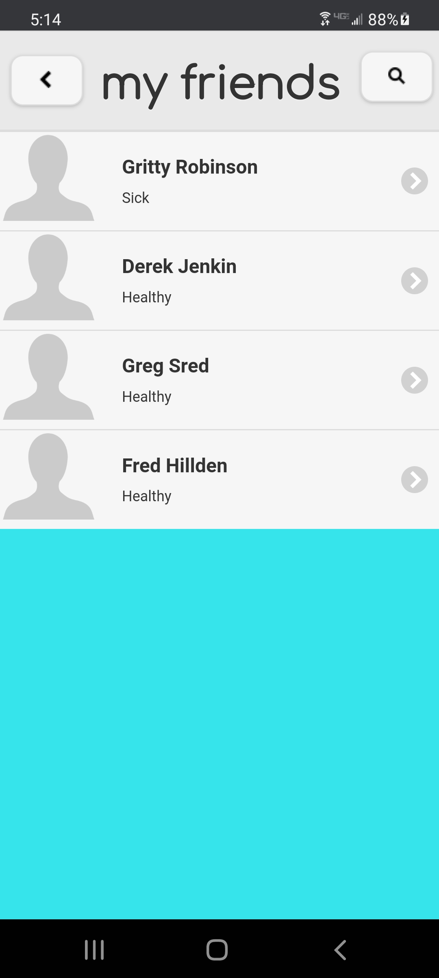
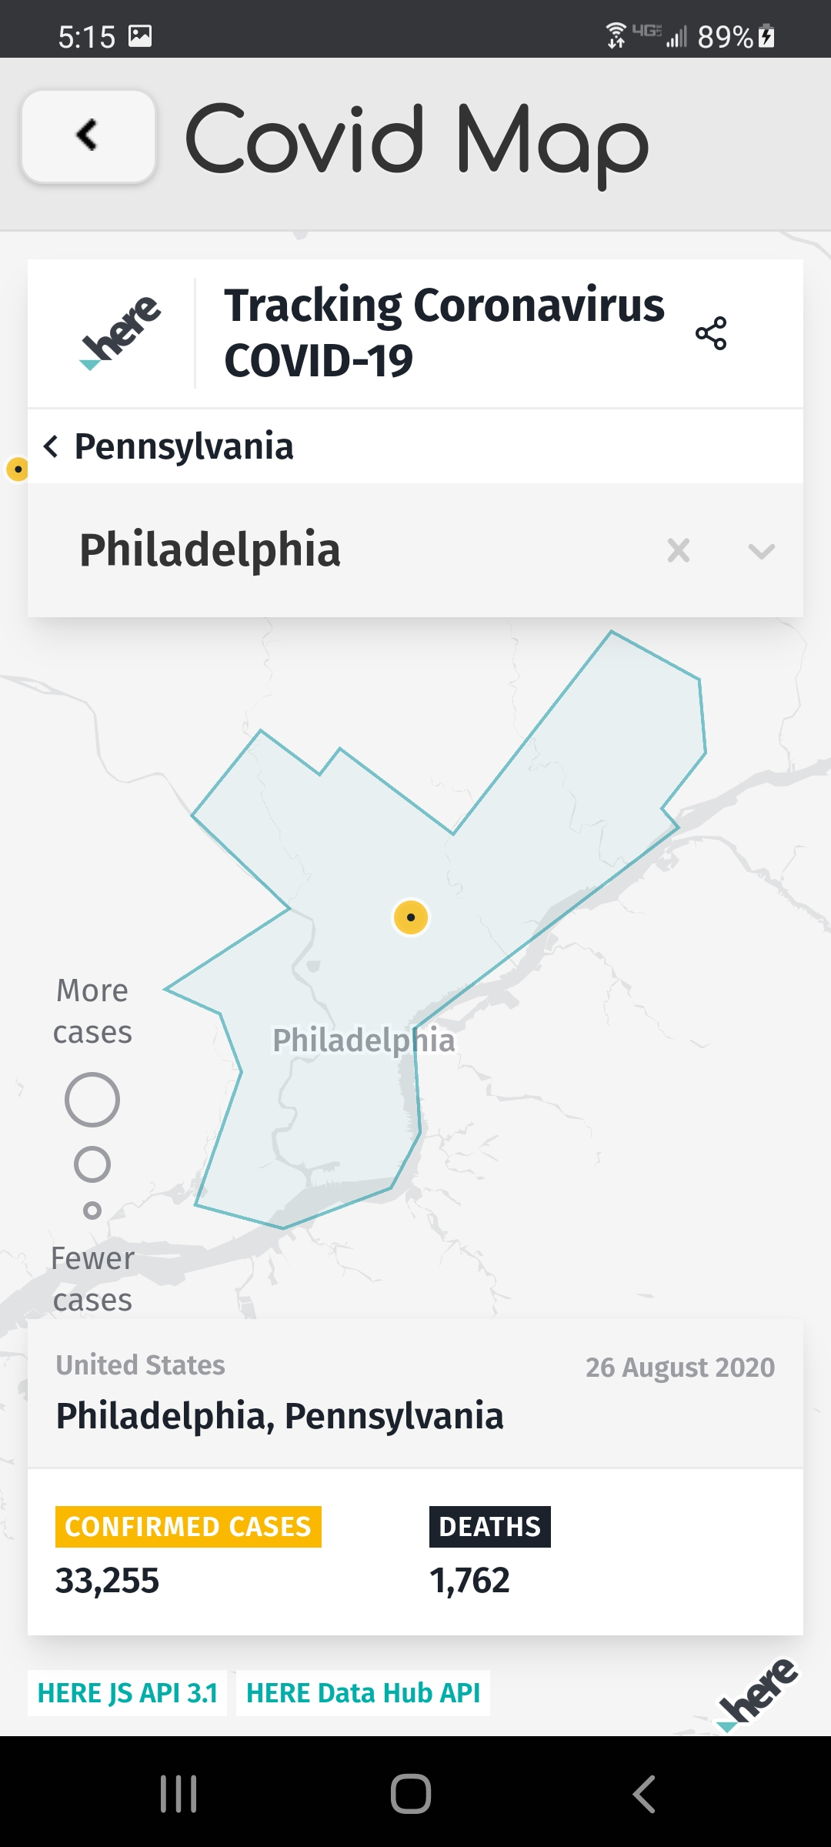
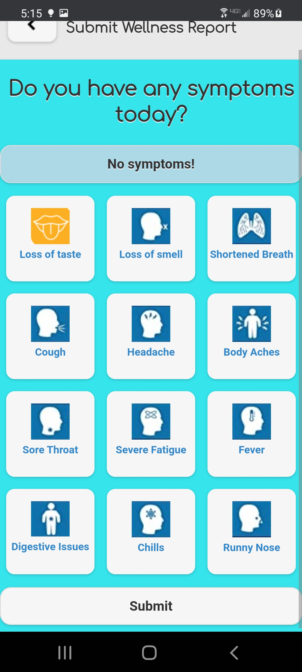
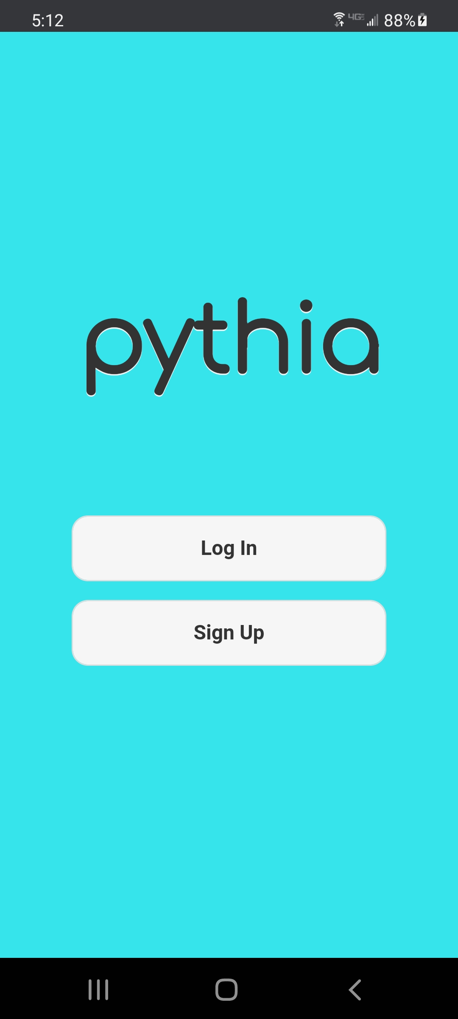
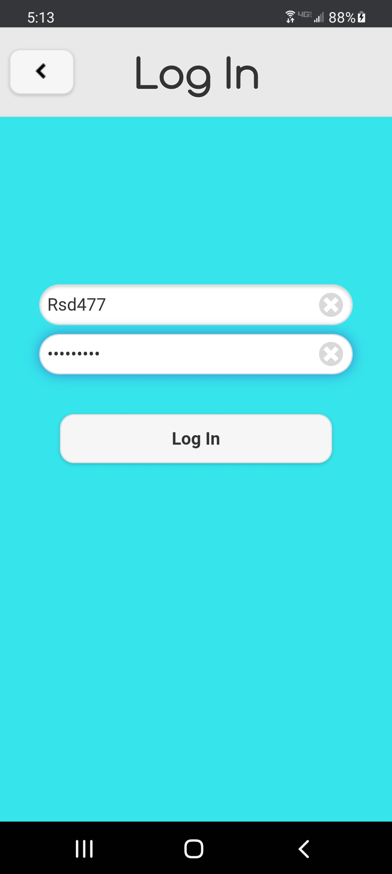
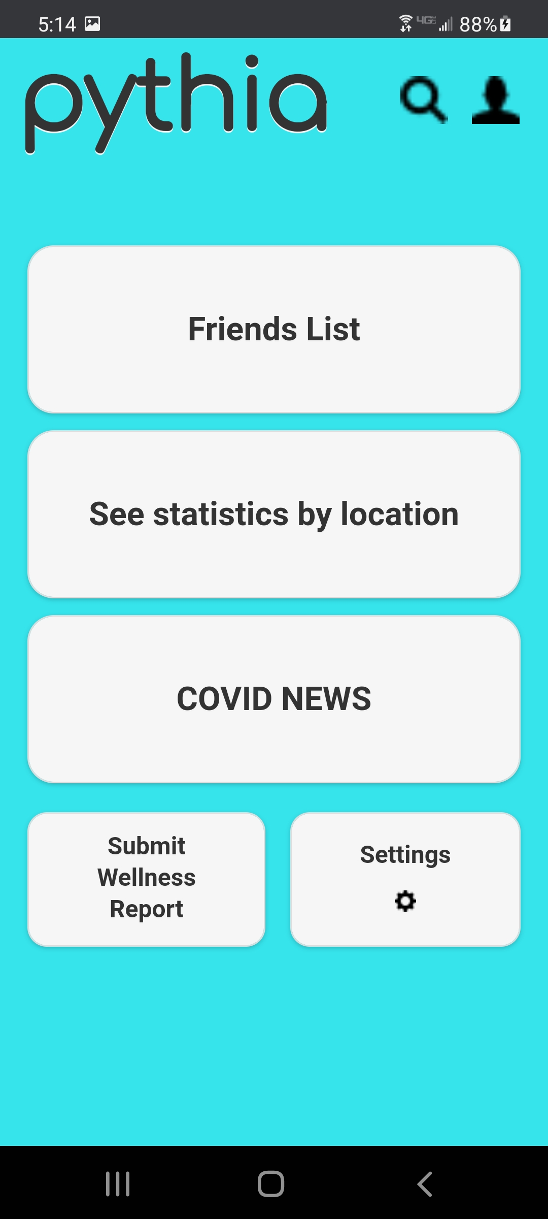
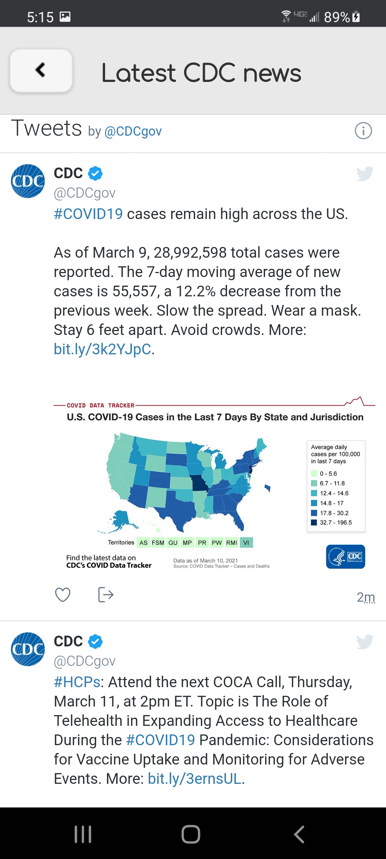
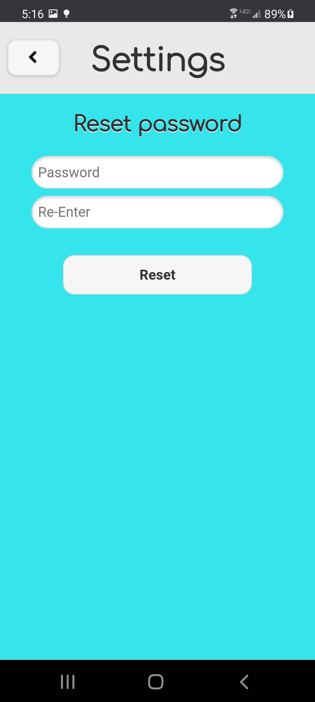
Main screens

Slide 4
Implementation
App allows user to add people they commonly interact with
Every user reports their covid test status and symptoms regularly
Users can view how their friends are doing and other people on the app
In the future, users will be notified by email when their friends test positive

Slide 5
Readme/usage
In demo mode: circumvent login/signup by going to sandbox.cci.drexel.edu:8948/members
Account locked on demo account: ‘rsd477’ no matter what sign in to show full app capabilities
Known Bugs:
when on covid map, refresh required before use
usernames are case sensitive

